Slide 1

Analysis of Twitter Data

Slide 2

Problem Statement
After a year-and-a-half long hiatus, many offices are opening up. Most companies are asking that employees return on a hybrid basis, meaning they come into the office at least some of the time. But what exactly that will look like is uncertain.
Hence, to understand people's view on whether they are comfortable with Work from home or they want to come back to offices , I considered analyzing the worldwide twitter data.
This project studied #workfromhome and #remotework related tweets to find out the opinions expressed by people.
Notes:
Even though many companies allowed their staff to work remotely before the COVID-19 pandemic hit the world, it became the new norm after that. As the pandemic spread, forcing the world to go into lockdown, business organizations were left with no other option than to switch to online working. As a result, there has been a drastic increase in the number of remote workers, lately.

Slide 3
Data
The data was collected by reading through Twitter API on from July 11,2021 to July 25,2021.Most recent and popular tweets from #workfromhome and #remotework were taken to conduct the analysis.
Below features were extracted from twitter :
1. Text of the tweet
2. User location
3. Date and Time the tweet was posted
4. Unique Id of the tweets
Total Tweets | Number Of Retweets | Actual Tweets
22054 | 7571 | 14483

Slide 4
Most Retweeted Tweets

Slide 5
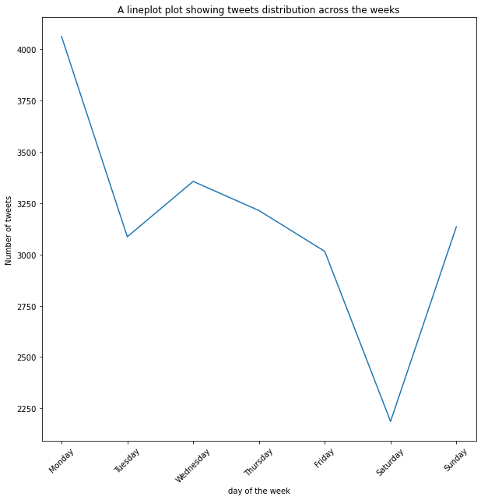
Tweets distribution on weekdays
Lowest tweeting activity on Saturday, then the frequency increases slowly up to Monday where the max is recorded

Slide 6
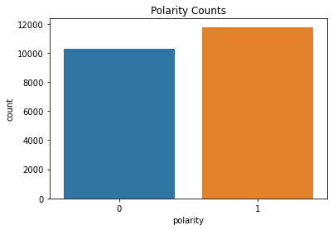
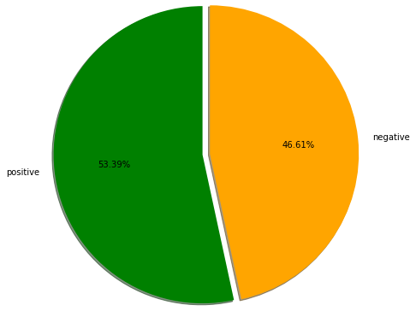
Polarity of the data
Nearly 12000 tweets are interpreted as positive whereas nearly 10000 tweets were interpreted as negative

Slide 7
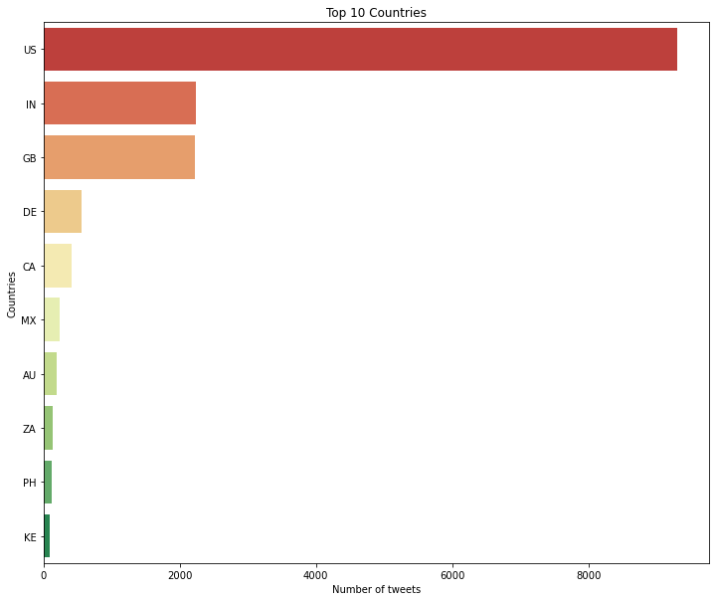
Most tweeted 10 countries
According to Sysomos research, Top 10 countries, number of Twitter users: USA, UK, Canada, Australia, Brazil, Germany, Netherlands, France, India, South Africa.

Slide 8
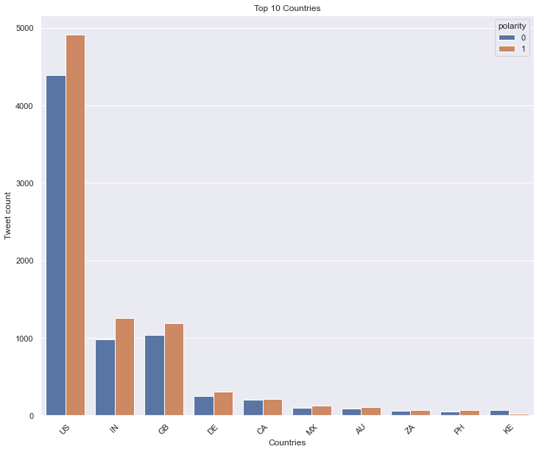
Number of positive and negative tweets in most tweeted 10 countries

Slide 9
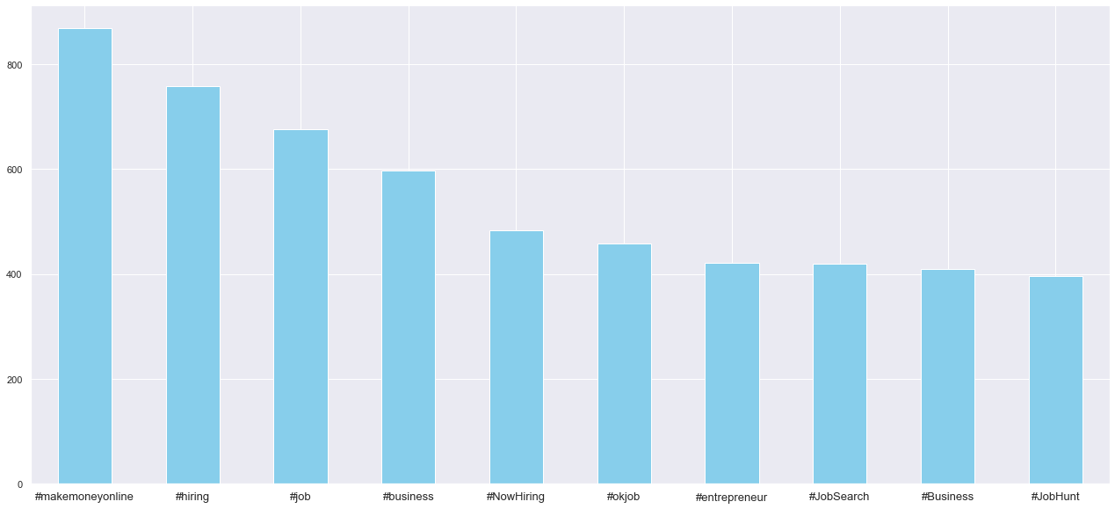
Most repetitive hashtags
Hashtags used in most of the data apart from #remotework and #workfromhome are mostly about remote jobs.

Slide 10
Most representative terms per cluster

Slide 11
Tweets of Cluster 0 and Cluster 2
Cluster 0 is about Remote Job Postings. Work Skills required for people interested to work from home
Did not find any pattern in Cluster 2 as most of the tweets had more hashtags than the text, there is no sync between the text and the hashtags used

Slide 12
Tweets of Cluster 1 and Cluster 3
Cluster 1 is about work from home impacts , hybrid work model and how companies can support employees on this new norm.
Cluster 3 is about Remote Job openings in IT sector. Most of them are for frontend ,backend developer , python developer for Senior level.

Slide 13
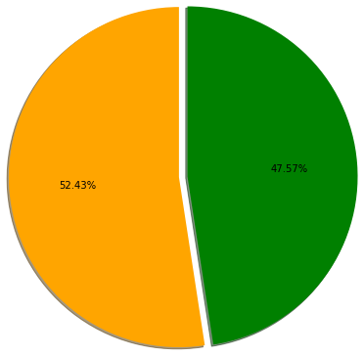
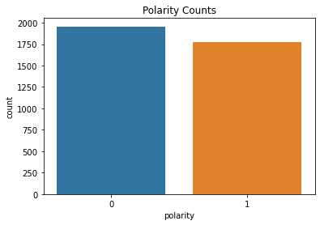
Polarity of the Cluster 1 data
Out of 3731 tweets , nearly 2000 tweets are interpreted as negative whereas 1750 tweets were interpreted as negative

Slide 14
Tweets about recent ‘Apple’ decision on work from home model
'Apple is reportedly trying a ‘retail flex’ work-from-home program for store employees\n#media #it’s #store #retail #office #remotework\nviahttps://t.co/L1GaIg35Zm\n☛ https://t.co/mOde65sx1k https://t.co/U2q10o7Cw5'
'You probably heard that @Apple wants its staff back in offices 3 days a week starting in early September.\n\nAnd what works best for you?\n#WFH #remotework'
Apple employees have written a letter expressing their frustration over Tim Cook's order to return to the office #Apple #remotework \n\nhttps://t.co/2I4Dj5dQzX"
#Apple employees push back against returning to the office in internal letter. (The Verge) #RemoteWork #FutureOfWork
'As #Apple plans to #reopen offices three days a week starting early September, reports have surfaced saying that the tech giant is allegedly discouraging #employees to #workfromhome.
'9to5Mac commentary on Apple’s Inflexibility on flexible working hours https://t.co/lmzJ6cfmFk Ben Lovejoy at 9to5Mac has a g #Covid-19 #JonahOnPremiere #RemoteEditing #WorkAtHome #WorkFromHome'
'Even Tech Giant APPLE @Apple has to deal with the WFH or Office debate. More employees want to continue being at home, more companies are demanding they come back!\nhttps://t.co/Nz67GUAjrY\n\nhttps://t.co/Mb2Y2uK9gF\n\n#WFH #remotework'
'#Apple employees are threatening to quit over the company’s “strict” #remotework policy, which requires workers to be in office at least three days a week\nhttps://t.co/6ZwJkTfCZX'
"Apple is forcing some disabled employees back to the office, even though they've been cleared to stay WFH under the Americans with Disabilities Act. Great reporting from @Hamilbug via @BusinessInsider \n\n#DisabilityTwitter #RemoteWork #FutureOfWork\n\nhttps://t.co/2U7gSSSYyg"
'#Employees, as per the report, have been talking about getting @Apple attention on the matter. In June, employees conducted an internal survey and more tan 35% weren’t comfortable with Apple’s #hybridworkmodel.\n\n#EmployeeExperience #remotework \n\nhttps://t.co/qN1dKbqSZ4'
"It has been reported that many Apple staff are quitting in response to that company's 'hard-line' approach to #RemoteWork. Given that Apple has allowed staff to work at home three days a work (i.e., #HybridWork), is this a sign of things to come? \n\nhttps://t.co/edzByDYcAS"
'Apple will require employees to return to the office three days a week starting in September, but staffers are unhappy with the inflexible manner of this arrangement.\n\n📧 Subscribe: https://t.co/MYc0D5YvOi\n\n#workplace #flexibility #remotework #hybridwork \n\nhttps://t.co/6srAT69epX'
'Apple employees sent a second letter to CEO @tim_cook and retail and people chief Deirdre O’Brien about the proposed return to the office. #remotework #WFH \nhttps://t.co/MbiUHaBj9d'

Slide 15

Next Steps
To conduct an online survey on remote work and use the survey results along with twitter data to analyze people's views.
Collect one to three months of twitter data
Using a trained sentiment analysis dataset and use twitter data as test data to predict sentiment of tweets. Compare and see if the results would vary between a trained dataset and BERT sentiment analyzer.

Slide 16


